Slide 1
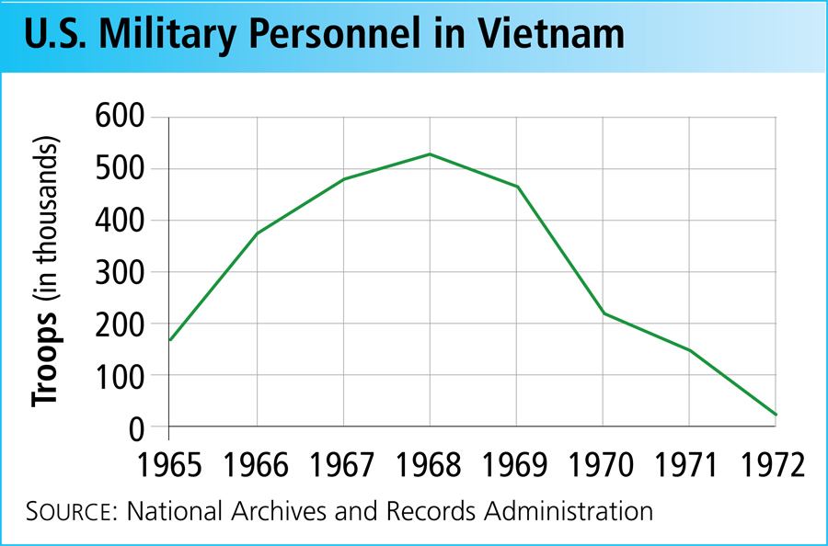
End and Impact of the Vietnam War 22-4

Slide 2
Terms and People
Vietnamization − Nixon’s plan for American forces to withdraw and South Vietnamese forces to assume more combat duties
Kent State University − site of a confrontation between students and National Guardsmen during which four students were killed
My Lai − a village in South Vietnam where American soldiers killed unarmed civilians

Slide 3
Terms and People (continued)
Pentagon Papers − classified government history of U.S. involvement in Vietnam, published by The New York Times in 1971
Paris Peace Accords − a 1973 agreement between the United States, South Vietnam, North Vietnam, and the Vietcong for a cease-fire and American troop withdrawal from South Vietnam
War Powers Act − passed in 1973, this act restricted the President’s war-making powers

Slide 4
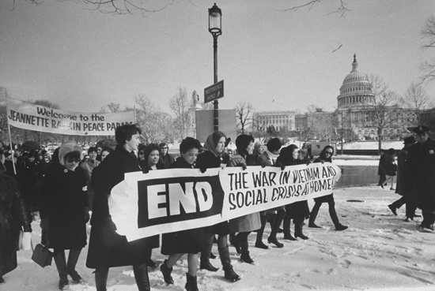
President Nixon inherited an unpopular war and increasing troubles on the home front.

Slide 5
Publicly, Nixon advocated
the Vietnamization of the war, which would transfer front-line fighting to the South Vietnamese.
“peace with honor”: American withdrawal from Vietnam on honorable terms.

Slide 6
Secretly, President Nixon
ordered the bombing of the Ho Chi Minh Trail in Cambodia to reduce the flow of supplies to the Vietcong.
extended the war with a ground attack by U.S. soldiers on North Vietnamese bases in Cambodia in 1970.

Slide 7
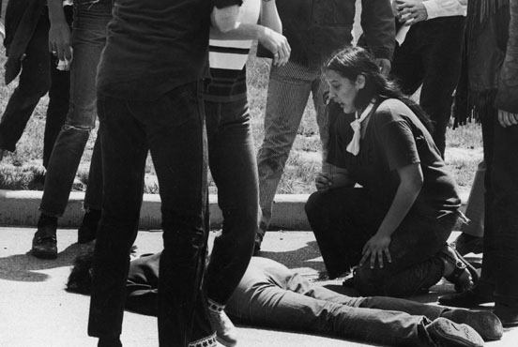
At home, protests escalated.
At Kent State University in Ohio, four students were shot by National Guardsmen in May of 1970.
A similar confrontation at Jackson State University in Mississippi left two students dead.
Counterprotests were held by those supporting Nixon and the war efforts.

Slide 8
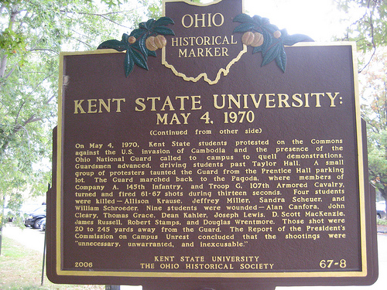

Slide 9
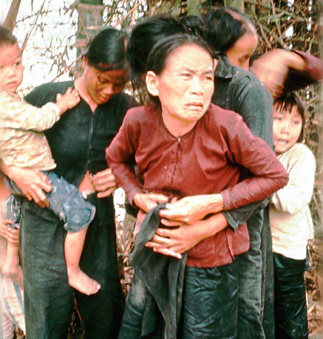
In 1971, Americans were stunned to learn about the My Lai massacre.
Four years earlier, U.S. soldiers searching for Vietcong in the village of My Lai had killed hundreds of unarmed civilians.

Slide 10
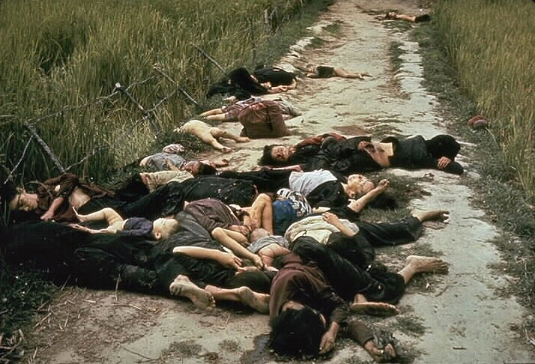

Slide 11
The publication of the Pentagon Papers further shocked the nation.
The report revealed that American leaders had lied to Congress and failed to inform the public fully about the American involvement in Vietnam.
Nixon tried to stop publication of the Pentagon Papers, but The New York Times published the report in 1971.

Slide 12
In January 1973, the war finally ended with the signing of the Paris Peace Accords.
The United States, South Vietnam, North Vietnam, and the Vietcong would stop fighting.
American troops would withdraw from South Vietnam.
North Vietnamese troops would remain in South Vietnam.
South Vietnam’s noncommunist government would remain in power.

Slide 13
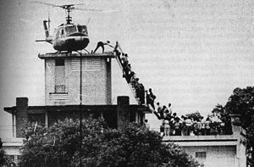
For the United States, the war was over, but fighting continued in Vietnam despite the peace agreement.
In the spring of 1975, North Vietnam invaded Saigon and won the war.

Slide 14
The Vietnam War had a lasting effect on American life.
More than 58,000 Americans died in Vietnam.
It would be years before Vietnam veterans were acknowledged for their sacrifices.
The war undermined Americans’ trust in their leaders.
Americans became reluctant to intervene in other nations’ affairs.
Congress passed the War Powers Act in 1973, restricting the President’s ability to send the nation to war.

Slide 15
War Powers Act
The War Powers Resolution requires the President to notify Congress within 48 hours of committing armed forces to military action and forbids armed forces from remaining for more than 60 days, with a further 30 day withdrawal period, without an authorization of the use of military force or a declaration of war. The resolution was passed by two-thirds of Congress, overriding a presidential veto.

